Slide 1
BIEN 401 Biomedical Mass Transport Class 6 More Examples with Diffusion
notes prepared by
Dr. Louis Reis
Created on 3/17/2022

Slide 2
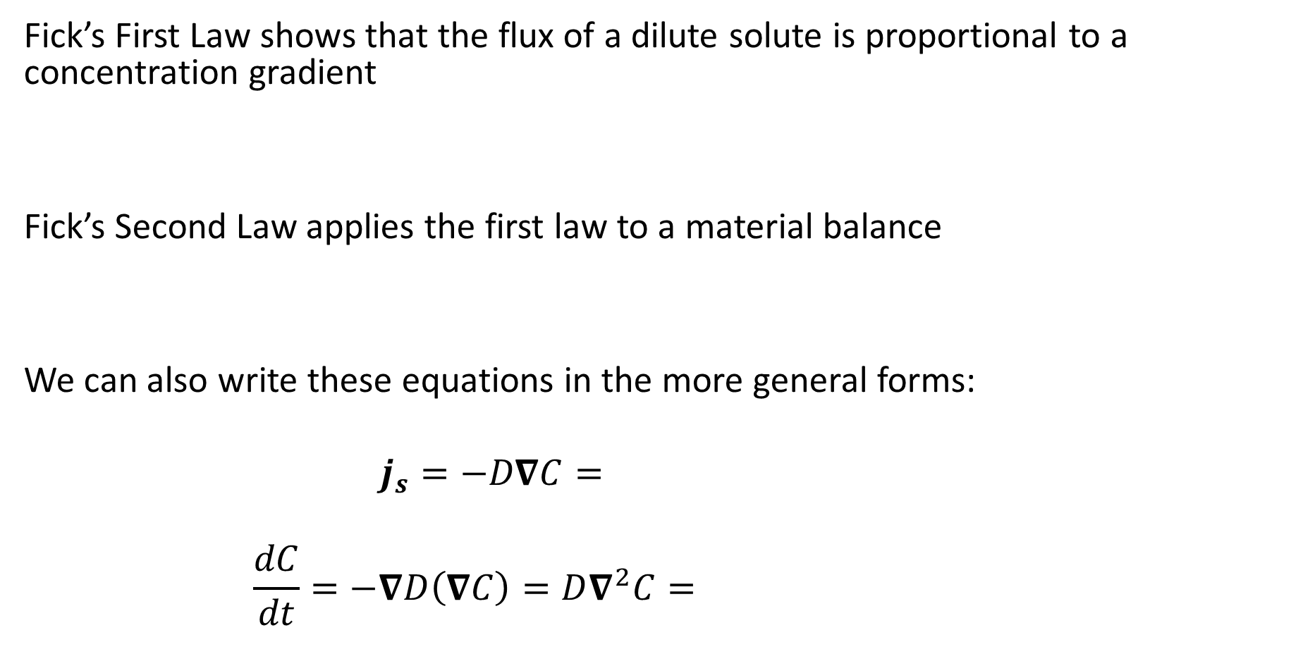
Fick’s Laws
Fick’s First Law shows that the flux of a dilute solute is proportional to a concentration gradient
Fick’s Second Law applies the first law to a material balance
We can also write these equations in the more general forms:
$$j_{s}=−D∇C=$$
$$\frac{dC}{dt}=−∇D\left(∇C\right)=D∇^{2}C=$$

Slide 3
Boundary Conditions
When looking at Fick’s Second Law (1D), we know that we will need 2 boundary conditions. Here are some examples of the boundary conditions you may encounter:
Concentration
If a surface is coated with a solute that is not removed from the surface too quickly, then we can assume the surface concentration is constant. However, to account for solubility differences between two contacting mediums, we can include a partition coefficient
In an infinite medium (or a large enough control volume over a small time window), we can assume that the solute concentration is unchanged from its initial value

Slide 4
Boundary Conditions
Solute Flux
If examining the interface between two mediums, the flux leaving one medium should equal the flux entering the second medium
If a non-permeable wall exists and solute cannot pass through, then the flux is 0

Slide 5
Boundary Conditions
Solute Flux
If the surface we are observing has a known mass transfer rate (commonly seen when looking at convection), we can write the flux condition in terms of the mass transfer coefficient
In some cases, a surface reaction may occur. The flux of the solute will be controlled by the reaction rate of the solute at the surface

Slide 6










Fick’s Laws Example Revisited
Let’s revisit the problem we did last class.
A block with a concentrated solute $C_{0}$ is placed in a still solvent fluid initially free of any solute. The solute will naturally diffuse from the surface of the block into the solvent above it. We developed an expression for concentration profile:
$$C\left(t,y\right)=C_{0}\operatorname{erfc}\left(\frac{y}{\sqrt{4Dt}}\right)$$
$$y$$
$$y$$
$$y$$
$$t=0$$
$$t>0$$
$$t≫0$$
$$C_{0}$$
$$C_{0}$$
$$C_{0}$$

Slide 7
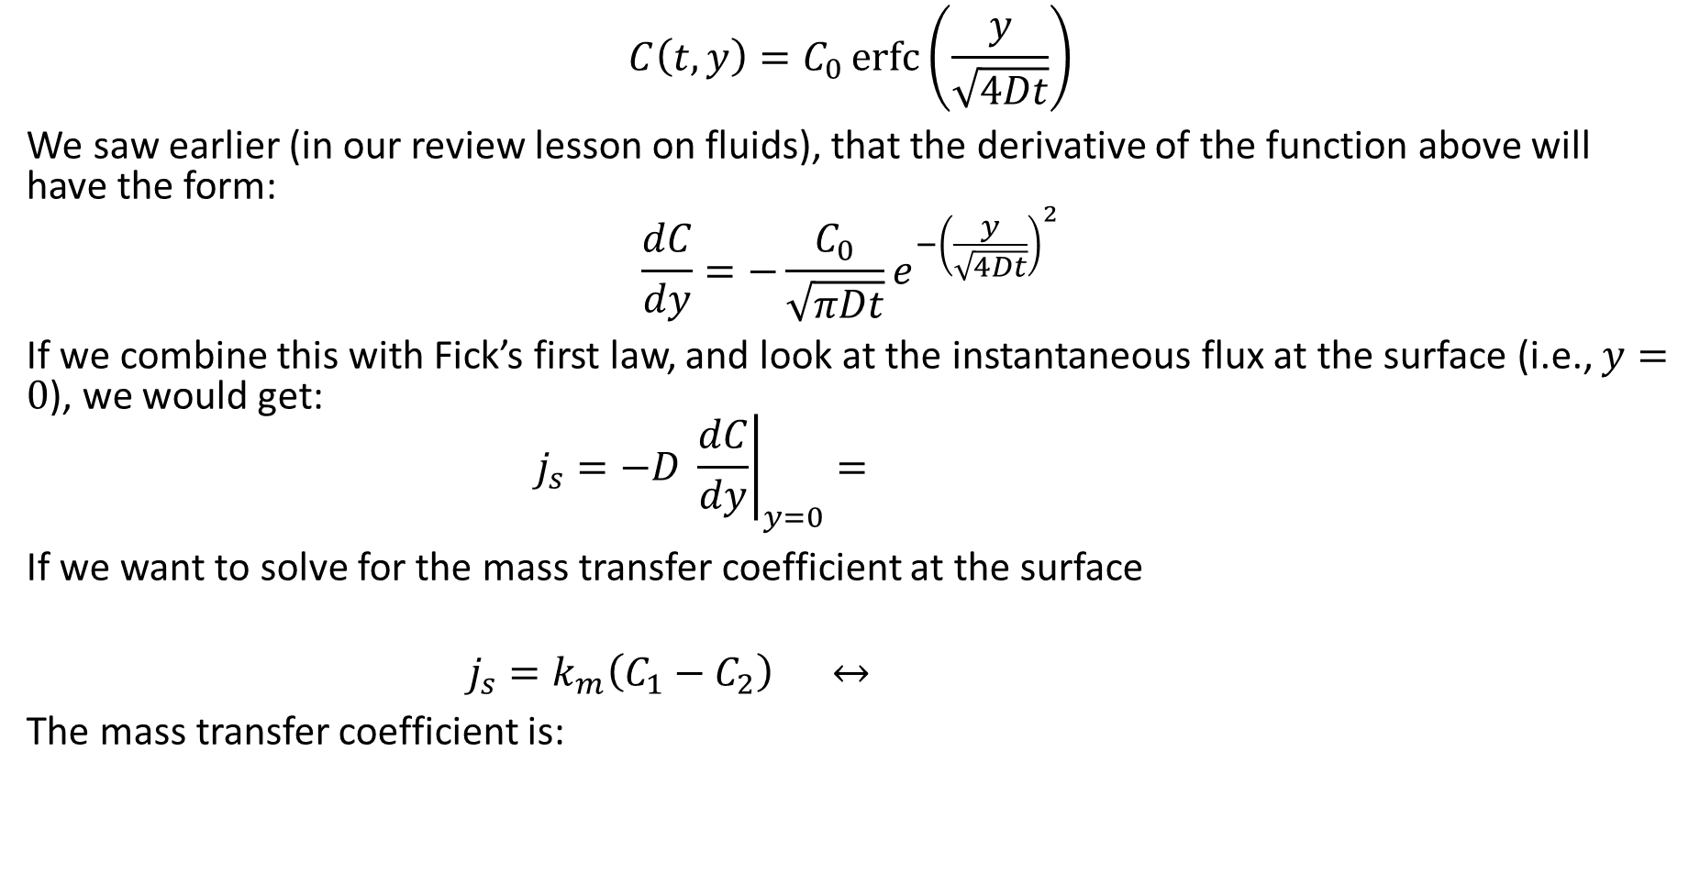
Fick’s Laws Example Revisited
$$C\left(t,y\right)=C_{0}\operatorname{erfc}\left(\frac{y}{\sqrt{4Dt}}\right)$$
We saw earlier (in our review lesson on fluids), that the derivative of the function above will have the form:
$$\frac{dC}{dy}=−\frac{C_{0}}{\sqrt{πDt}}e^{−{\left(\frac{y}{\sqrt{4Dt}}\right)}^{2}}$$
If we combine this with Fick’s first law, and look at the instantaneous flux at the surface (i.e., $y=0$), we would get:
$$j_{s}=−D {\left.\frac{dC}{dy}\right|}_{y=0}=$$
If we want to solve for the mass transfer coefficient at the surface
$$j_{s}=k_{m}\left(C_{1}−C_{2}\right) ↔$$
The mass transfer coefficient is:

Slide 8
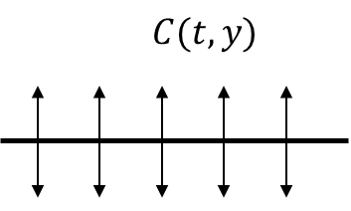
Another Example
Consider the following example:
A flat wafer of negligible thickness is introduced into a solvent fluid. The wafer will disintegrate in the solution and the solute will diffuse outward from the wafer in both directions.
Note this problem is different from the earlier we just looked at. In this case, diffusion occurs in both directions (up and down). There is also a finite amount of solute that can dissolve.

Slide 9
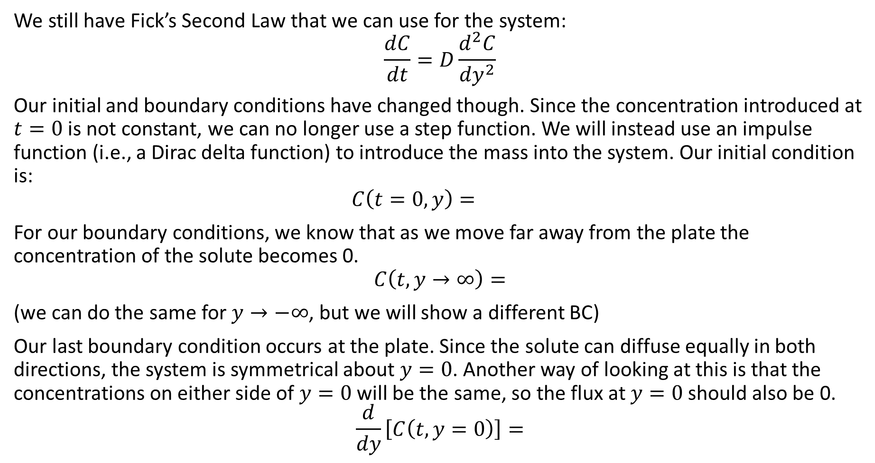

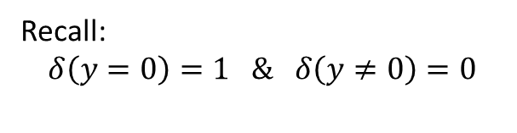
Another Example
We still have Fick’s Second Law that we can use for the system:
$$\frac{dC}{dt}=D\frac{d^{2}C}{dy^{2}}$$
Our initial and boundary conditions have changed though. Since the concentration introduced at $t=0$ is not constant, we can no longer use a step function. We will instead use an impulse function (i.e., a Dirac delta function) to introduce the mass into the system. Our initial condition is:
$$C\left(t=0,y\right)=$$
For our boundary conditions, we know that as we move far away from the plate the concentration of the solute becomes 0.
$$C\left(t,y→∞\right)=$$
(we can do the same for $y→−∞$, but we will show a different BC)
Our last boundary condition occurs at the plate. Since the solute can diffuse equally in both directions, the system is symmetrical about $y=0$. Another way of looking at this is that the concentrations on either side of $y=0$ will be the same, so the flux at $y=0$ should also be 0.
$$\frac{d}{dy}\left[C\left(t,y=0\right)\right]=$$
Recall:
$$δ\left(y=0\right)=1 \& δ\left(y≠0\right)=0$$
Concentration of flat plate:
$${\hat{C}}_{0}≡\left[\frac{mol}{cm^{2}}\right]$$

Slide 10
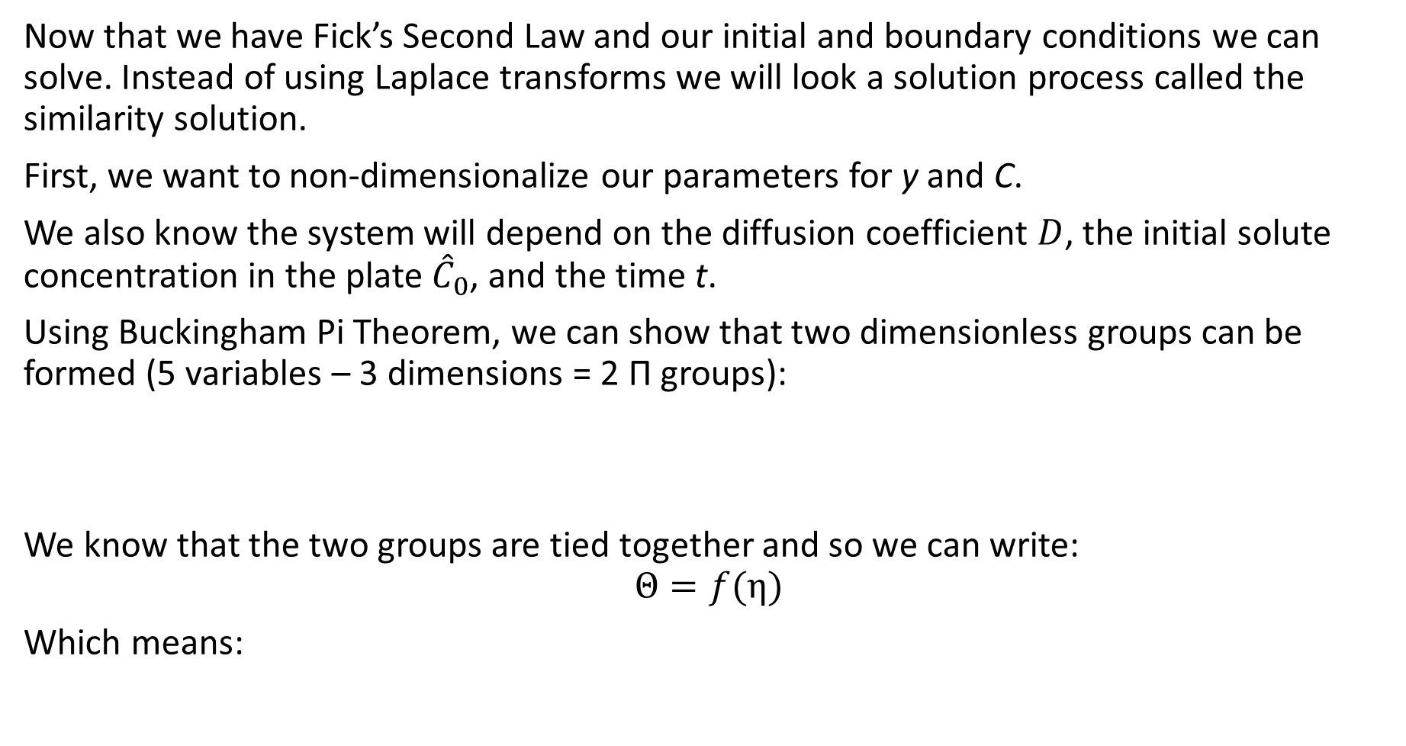
Similarity Solution
Now that we have Fick’s Second Law and our initial and boundary conditions we can solve. Instead of using Laplace transforms we will look a solution process called the similarity solution.
First, we want to non-dimensionalize our parameters for y and C.
We also know the system will depend on the diffusion coefficient $D$, the initial solute concentration in the plate ${\hat{C}}_{0}$, and the time t.
Using Buckingham Pi Theorem, we can show that two dimensionless groups can be formed (5 variables – 3 dimensions = 2 Π groups):
We know that the two groups are tied together and so we can write:
$$Θ=f(η)$$
Which means:

Slide 11
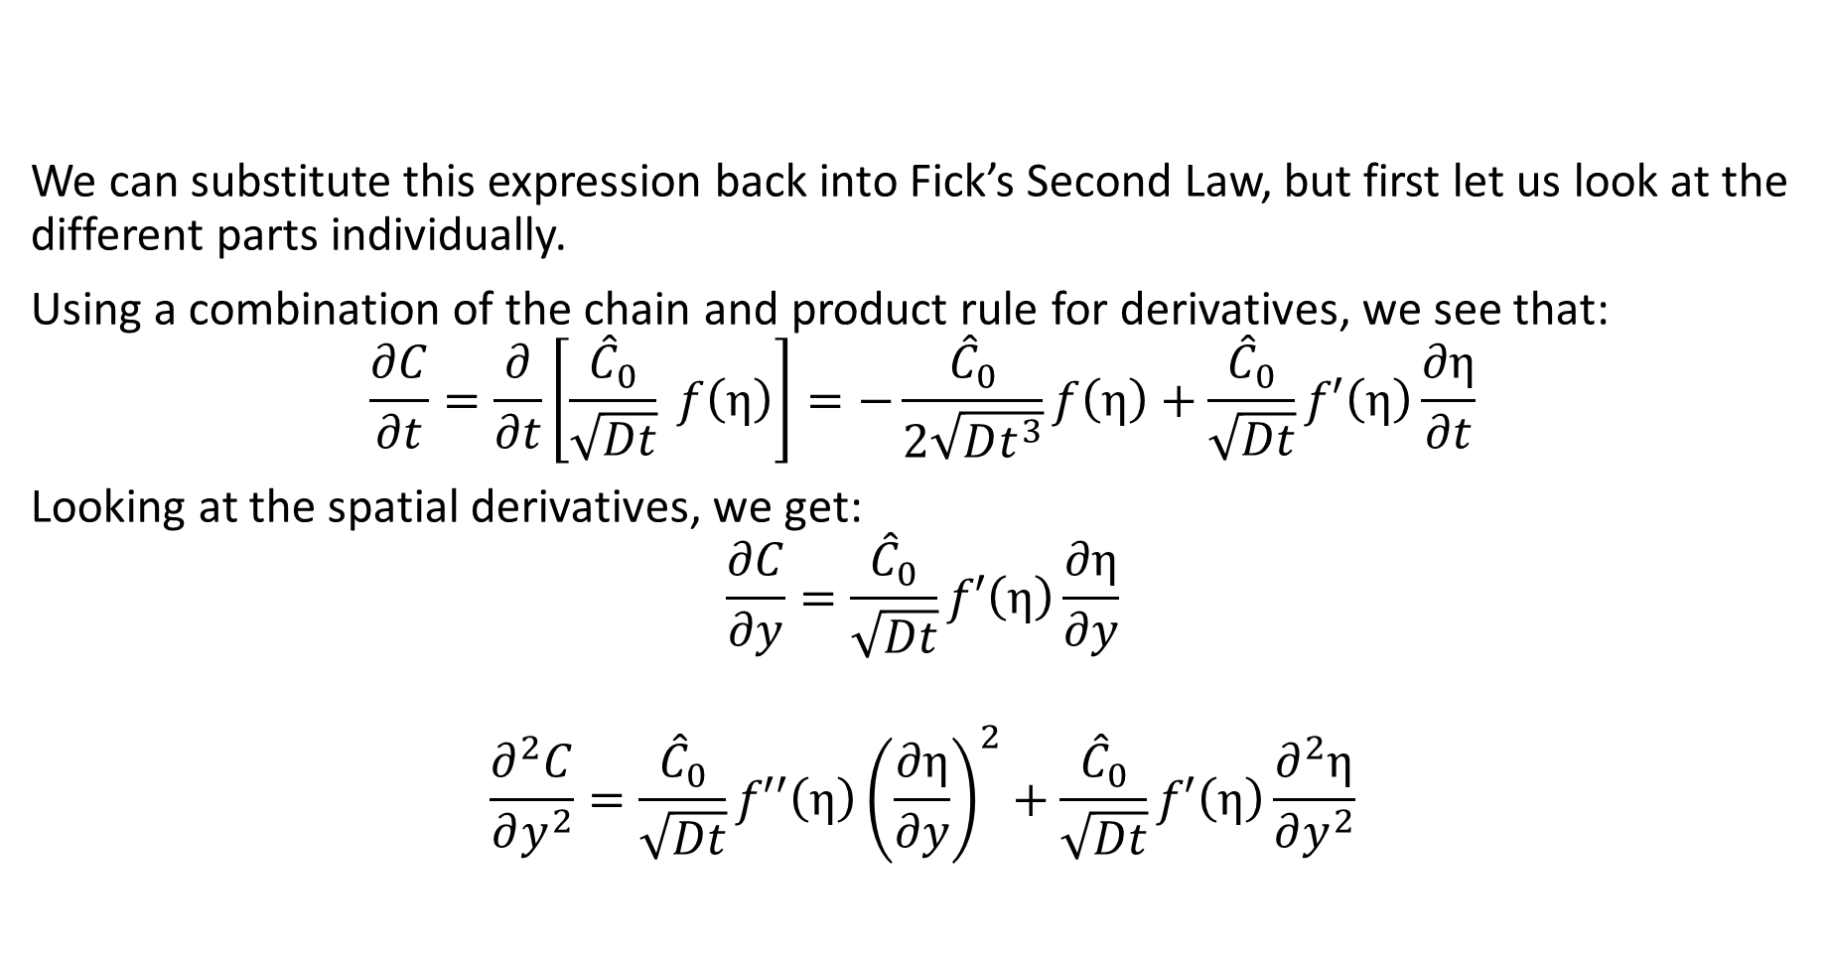
Similarity Solution
We can substitute this expression back into Fick’s Second Law, but first let us look at the different parts individually.
Using a combination of the chain and product rule for derivatives, we see that:
$$\frac{∂C}{∂t}=\frac{∂}{∂t}\left[\frac{{\hat{C}}_{0}}{\sqrt{Dt}} f\left(η\right)\right]=−\frac{{\hat{C}}_{0}}{2\sqrt{Dt^{3}}}f\left(η\right)+\frac{{\hat{C}}_{0}}{\sqrt{Dt}}f′\left(η\right)\frac{∂η}{∂t}$$
Looking at the spatial derivatives, we get:
$$\frac{∂C}{∂y}=\frac{{\hat{C}}_{0}}{\sqrt{Dt}}f′\left(η\right)\frac{∂η}{∂y}$$
$$\frac{∂^{2}C}{∂y^{2}}=\frac{{\hat{C}}_{0}}{\sqrt{Dt}}f′′\left(η\right){\left(\frac{∂η}{∂y}\right)}^{2}+\frac{{\hat{C}}_{0}}{\sqrt{Dt}}f′\left(η\right)\frac{∂^{2}η}{∂y^{2}}$$

Slide 12
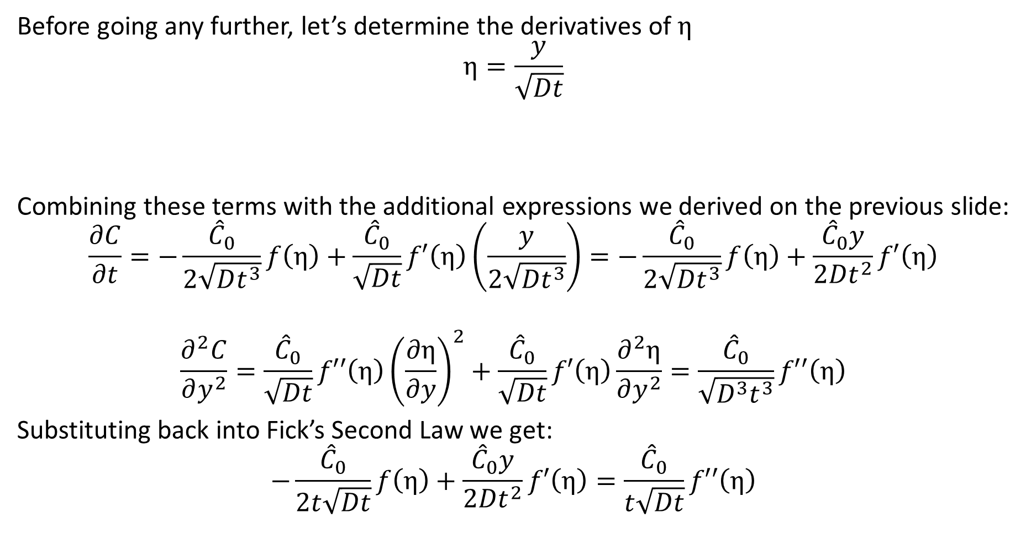
Similarity Solution
Before going any further, let’s determine the derivatives of $η$
$$η=\frac{y}{\sqrt{Dt}}$$
Combining these terms with the additional expressions we derived on the previous slide:
$$\frac{∂C}{∂t}=−\frac{{\hat{C}}_{0}}{2\sqrt{Dt^{3}}}f\left(η\right)+\frac{{\hat{C}}_{0}}{\sqrt{Dt}}f′\left(η\right)\left(\frac{y}{2\sqrt{Dt^{3}}}\right)=−\frac{{\hat{C}}_{0}}{2\sqrt{Dt^{3}}}f\left(η\right)+\frac{{\hat{C}}_{0}y}{2Dt^{2}}f′\left(η\right)$$
$$\frac{∂^{2}C}{∂y^{2}}=\frac{{\hat{C}}_{0}}{\sqrt{Dt}}f′′\left(η\right){\left(\frac{∂η}{∂y}\right)}^{2}+\frac{{\hat{C}}_{0}}{\sqrt{Dt}}f′\left(η\right)\frac{∂^{2}η}{∂y^{2}}=\frac{{\hat{C}}_{0}}{\sqrt{D^{3}t^{3}}}f′′\left(η\right)$$
Substituting back into Fick’s Second Law we get:
$$−\frac{{\hat{C}}_{0}}{2t\sqrt{Dt}}f\left(η\right)+\frac{{\hat{C}}_{0}y}{2Dt^{2}}f′\left(η\right)=\frac{{\hat{C}}_{0}}{t\sqrt{Dt}}f′′\left(η\right)$$

Slide 13
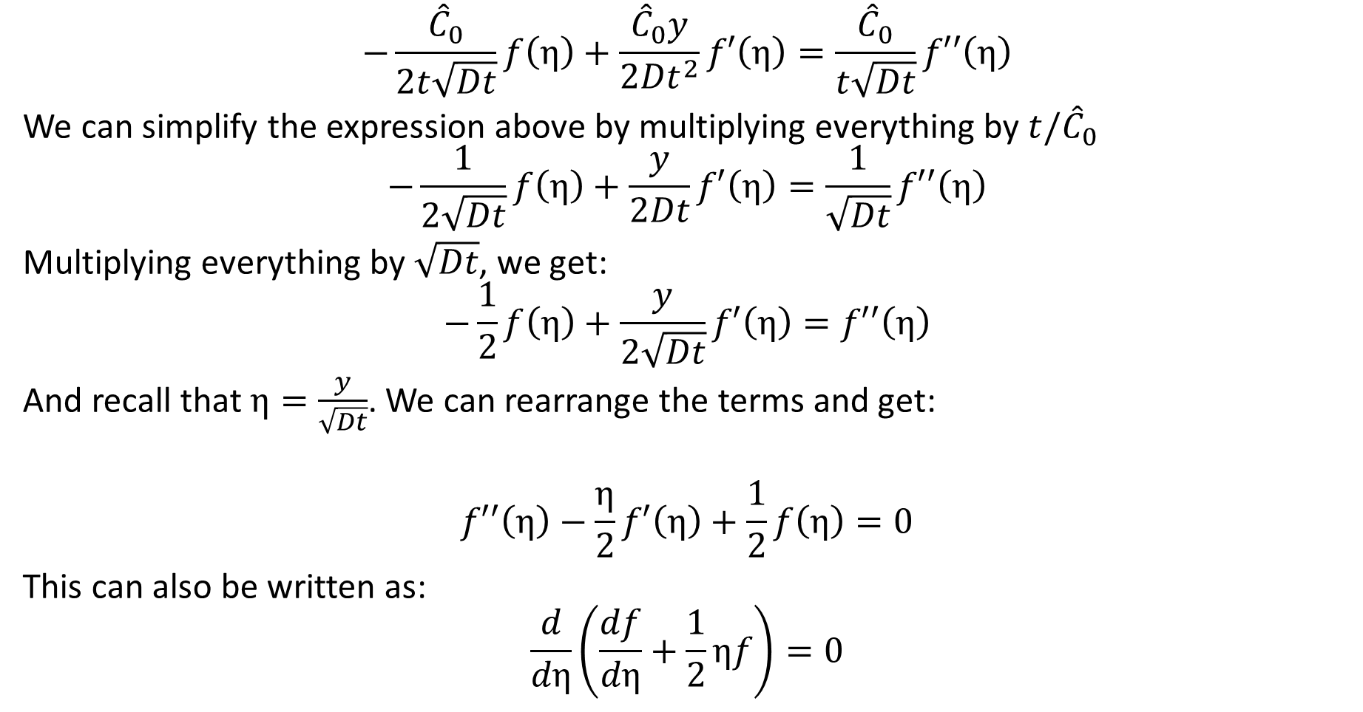
Similarity Solution
$$−\frac{{\hat{C}}_{0}}{2t\sqrt{Dt}}f\left(η\right)+\frac{{\hat{C}}_{0}y}{2Dt^{2}}f′\left(η\right)=\frac{{\hat{C}}_{0}}{t\sqrt{Dt}}f′′\left(η\right)$$
We can simplify the expression above by multiplying everything by $t/{\hat{C}}_{0}$
$$−\frac{1}{2\sqrt{Dt}}f\left(η\right)+\frac{y}{2Dt}f′\left(η\right)=\frac{1}{\sqrt{Dt}}f′′\left(η\right)$$
Multiplying everything by $\sqrt{Dt}$, we get:
$$−\frac{1}{2}f\left(η\right)+\frac{y}{2\sqrt{Dt}}f′\left(η\right)=f′′\left(η\right)$$
And recall that $η=\frac{y}{\sqrt{Dt}}$. We can rearrange the terms and get:
$$f′′\left(η\right)−\frac{η}{2}f′\left(η\right)+\frac{1}{2}f\left(η\right)=0$$
This can also be written as:
$$\frac{d}{dη}\left(\frac{df}{dη}+\frac{1}{2}ηf\right)=0$$

Slide 14
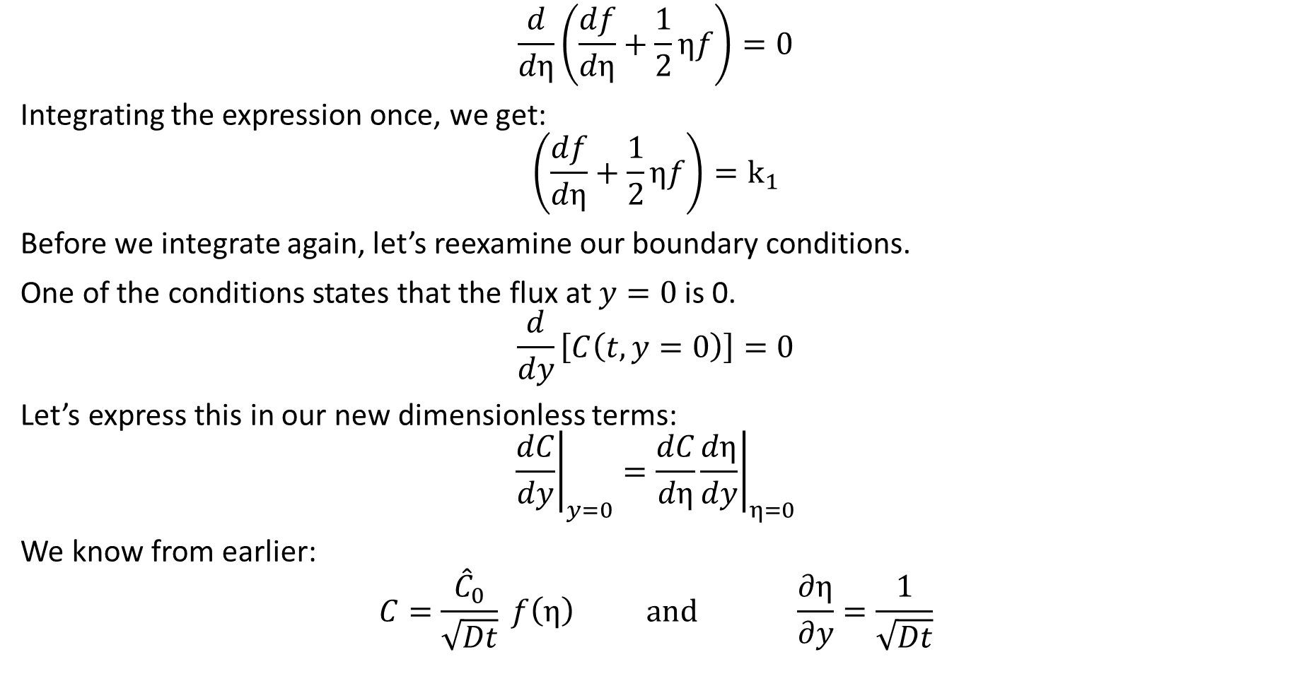
Similarity Solution
$$\frac{d}{dη}\left(\frac{df}{dη}+\frac{1}{2}ηf\right)=0$$
Integrating the expression once, we get:
$$\left(\frac{df}{dη}+\frac{1}{2}ηf\right)=k_{1}$$
Before we integrate again, let’s reexamine our boundary conditions.
One of the conditions states that the flux at $y=0$ is 0.
$$\frac{d}{dy}\left[C\left(t,y=0\right)\right]=0$$
Let’s express this in our new dimensionless terms:
$${\left.\frac{dC}{dy}\right|}_{y=0}=\frac{dC}{dη}{\left.\frac{dη}{dy}\right|}_{η=0}$$
We know from earlier:
$$C=\frac{{\hat{C}}_{0}}{\sqrt{Dt}} f\left(η\right) \text{and} \frac{∂η}{∂y}=\frac{1}{\sqrt{Dt}}$$

Slide 15
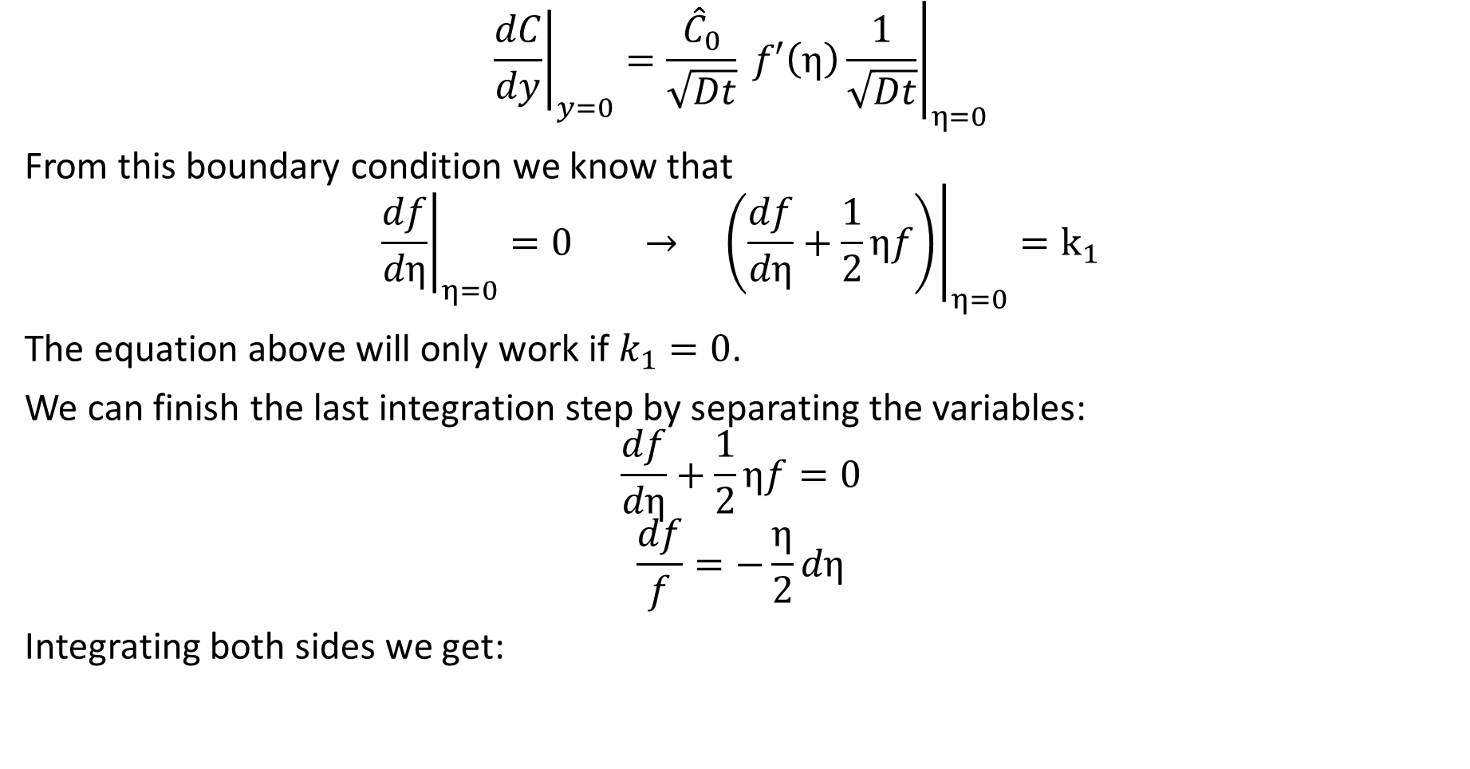
Similarity Solution
$${\left.\frac{dC}{dy}\right|}_{y=0}={\left.\frac{{\hat{C}}_{0}}{\sqrt{Dt}} f′\left(η\right)\frac{1}{\sqrt{Dt}}\right|}_{η=0}$$
From this boundary condition we know that
$${\left.\frac{df}{dη}\right|}_{η=0}=0 → {\left.\left(\frac{df}{dη}+\frac{1}{2}ηf\right)\right|}_{η=0}=k_{1}$$
The equation above will only work if $k_{1}=0$.
We can finish the last integration step by separating the variables:
$$\frac{df}{dη}+\frac{1}{2}ηf=0$$
$$\frac{df}{f}=−\frac{η}{2}dη$$
Integrating both sides we get:

Slide 16
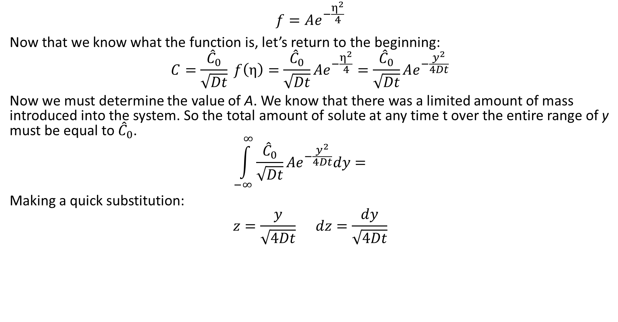
Similarity Solution
$$f=Ae^{−\frac{η^{2}}{4}}$$
Now that we know what the function is, let’s return to the beginning:
$$C=\frac{{\hat{C}}_{0}}{\sqrt{Dt}} f\left(η\right)=\frac{{\hat{C}}_{0}}{\sqrt{Dt}}Ae^{−\frac{η^{2}}{4}}=\frac{{\hat{C}}_{0}}{\sqrt{Dt}}Ae^{−\frac{y^{2}}{4Dt}}$$
Now we must determine the value of A. We know that there was a limited amount of mass introduced into the system. So the total amount of solute at any time t over the entire range of y must be equal to ${\hat{C}}_{0}$.
$$\int_{−∞}^{∞}{\frac{{\hat{C}}_{0}}{\sqrt{Dt}}Ae^{−\frac{y^{2}}{4Dt}}dy}=$$
Making a quick substitution:
$$z=\frac{y}{\sqrt{4Dt}} dz=\frac{dy}{\sqrt{4Dt}}$$

Slide 17

Similarity Solution
$$A\int_{−∞}^{∞}{e^{−z^{2}}dz}=1$$
You should note that the expression in the integral is the Gaussian curve. And recall the integral of that function is equal to $\sqrt{π}$
So our final equation for the concentration profile is:

Slide 18
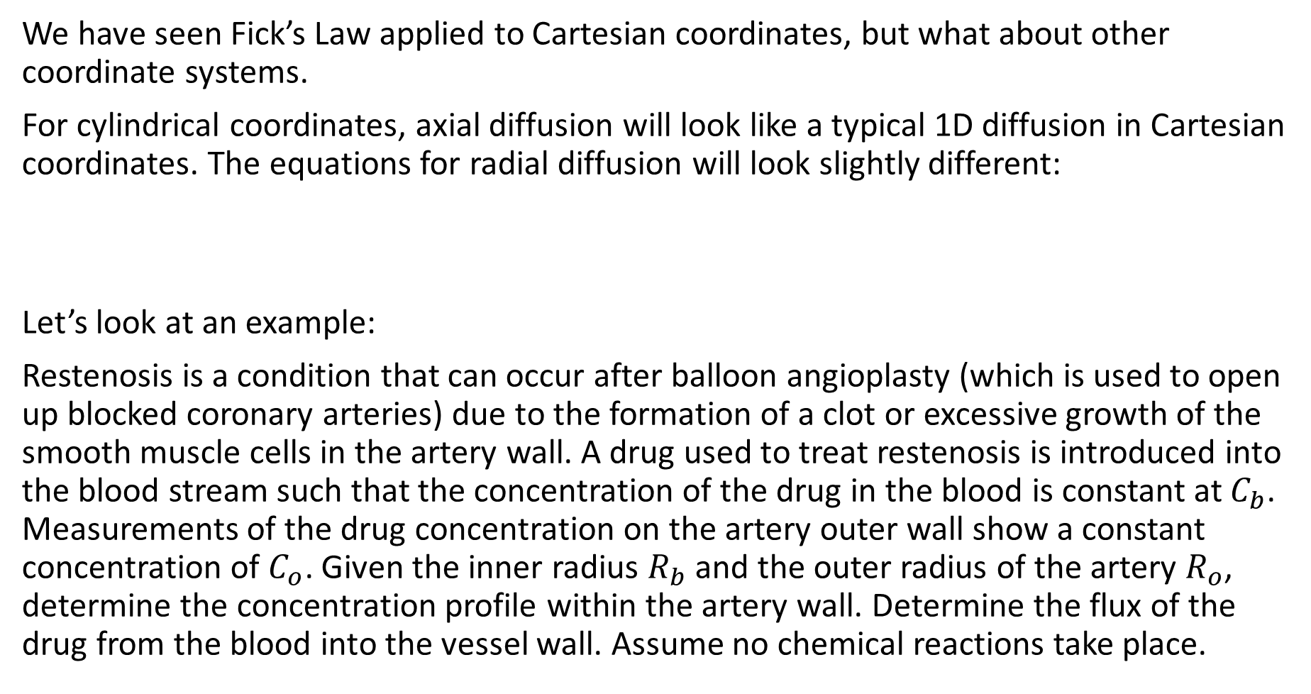
Diffusion in Cylindrical Coordinates
We have seen Fick’s Law applied to Cartesian coordinates, but what about other coordinate systems.
For cylindrical coordinates, axial diffusion will look like a typical 1D diffusion in Cartesian coordinates. The equations for radial diffusion will look slightly different:
Let’s look at an example:
Restenosis is a condition that can occur after balloon angioplasty (which is used to open up blocked coronary arteries) due to the formation of a clot or excessive growth of the smooth muscle cells in the artery wall. A drug used to treat restenosis is introduced into the blood stream such that the concentration of the drug in the blood is constant at $C_{b}$. Measurements of the drug concentration on the artery outer wall show a constant concentration of $C_{o}$. Given the inner radius $R_{b}$ and the outer radius of the artery $R_{o}$, determine the concentration profile within the artery wall. Determine the flux of the drug from the blood into the vessel wall. Assume no chemical reactions take place.

Slide 19
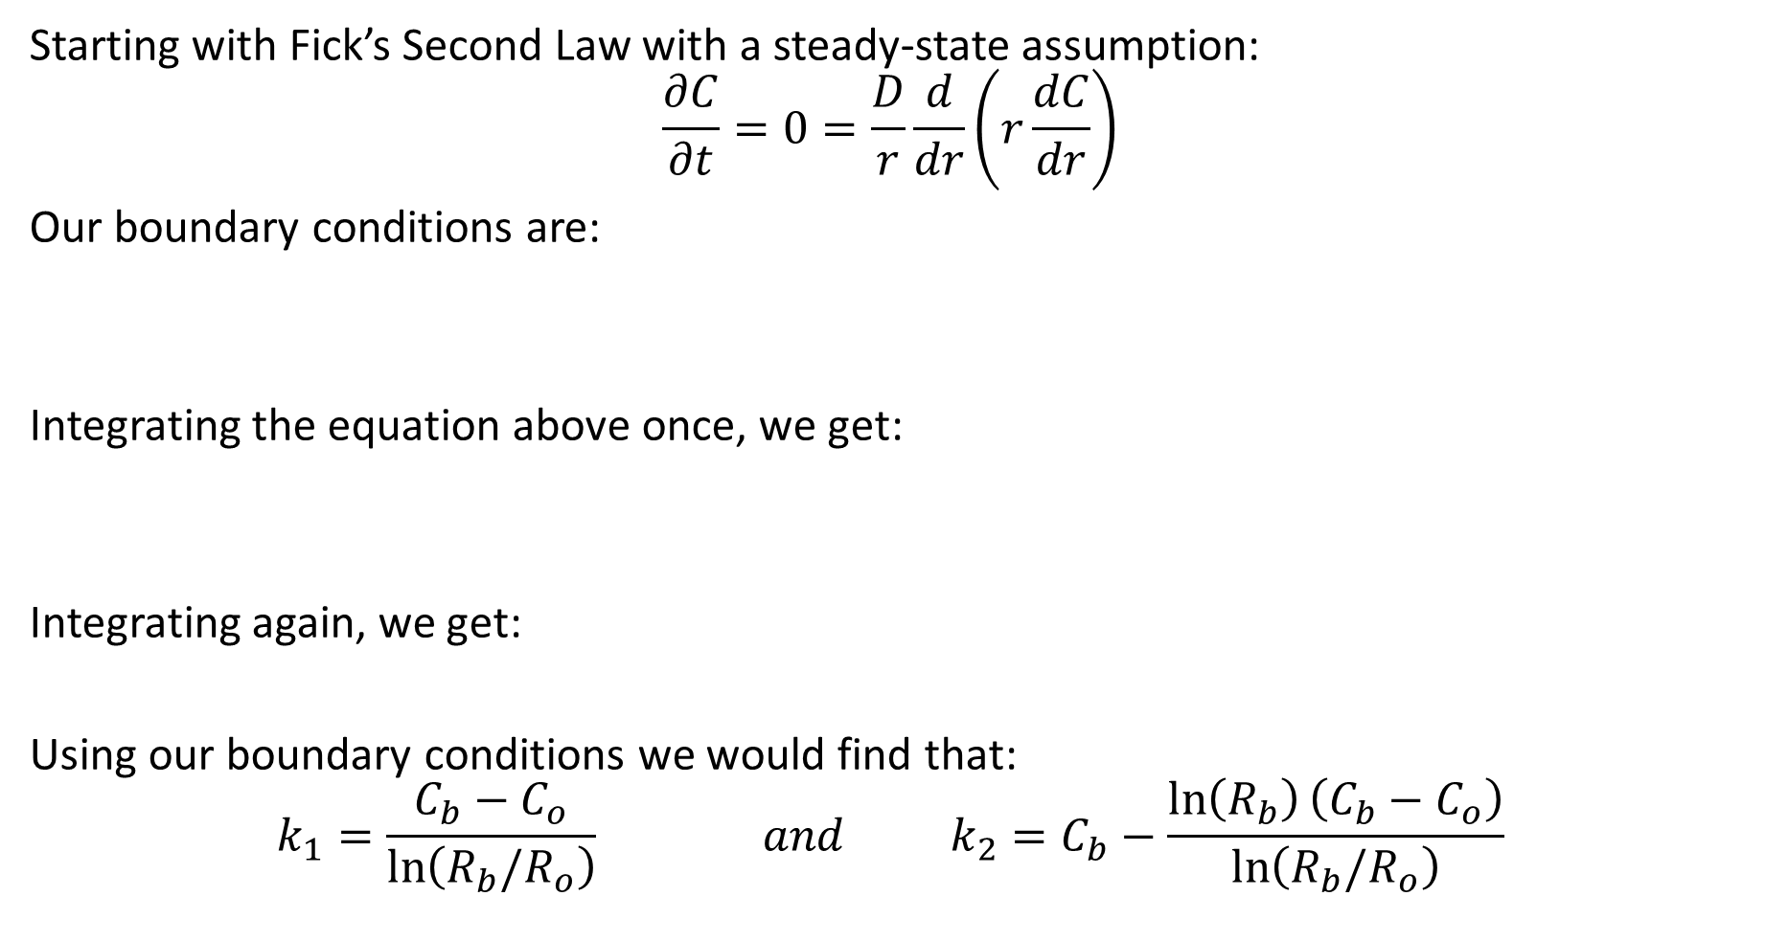
Diffusion in Cylindrical Coordinates
Starting with Fick’s Second Law with a steady-state assumption:
$$\frac{∂C}{∂t}=0=\frac{D}{r}\frac{d}{dr}\left(r\frac{dC}{dr}\right)$$
Our boundary conditions are:
Integrating the equation above once, we get:
Integrating again, we get:
Using our boundary conditions we would find that:
$$k_{1}=\frac{C_{b}−C_{o}}{\ln\left(R_{b}/R_{o}\right)} and k_{2}=C_{b}−\frac{\ln\left(R_{b}\right)\left(C_{b}−C_{o}\right)}{\ln\left(R_{b}/R_{o}\right)}$$

Slide 20

Diffusion in Cylindrical Coordinates
The final equation will look like:
$$C\left(r\right)=C_{b}+\frac{\ln\left(r/R_{b}\right)\left(C_{b}−C_{o}\right)}{\ln\left(R_{b}/R_{o}\right)}$$
We can find the flux at the inner wall of the blood vessel using Fick’s First Law:
$$j_{s}=−D{\left.\frac{dC}{dr}\right|}_{r=R_{b}}=$$
If we wanted to find the mass transfer coefficient $k_{m}$

Slide 21

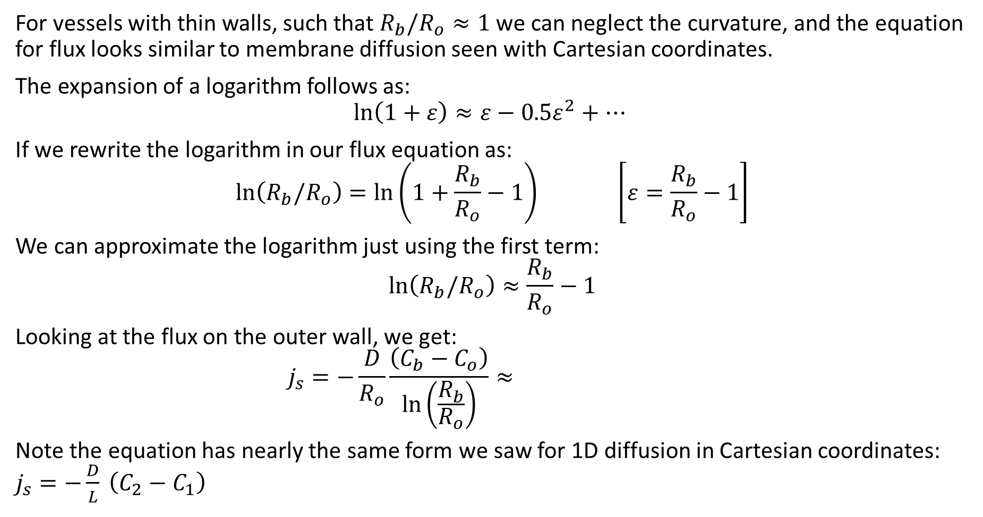
Thin-wall assumption
For vessels with thin walls, such that $R_{b}/R_{o}≈1$ we can neglect the curvature, and the equation for flux looks similar to membrane diffusion seen with Cartesian coordinates.
The expansion of a logarithm follows as:
$$\ln\left(1+ε\right)≈ε−0.5ε^{2}+…$$
If we rewrite the logarithm in our flux equation as:
$$\ln\left(R_{b}/R_{o}\right)=\ln\left(1+\frac{R_{b}}{R_{o}}−1\right) \left[ε=\frac{R_{b}}{R_{o}}−1\right]$$
We can approximate the logarithm just using the first term:
$$\ln\left(R_{b}/R_{o}\right)≈\frac{R_{b}}{R_{o}}−1$$
Looking at the flux on the outer wall, we get:
$$j_{s}=−\frac{D}{R_{o}}\frac{\left(C_{b}−C_{o}\right)}{\ln\left(\frac{R_{b}}{R_{o}}\right)}≈$$
Note the equation has nearly the same form we saw for 1D diffusion in Cartesian coordinates: $j_{s}=−\frac{D}{L} \left(C_{2}−C_{1}\right)$
Quick note:
This assumption is fairly valid when $\frac{R_{b}}{R_{o}}<1.1$. When $\frac{R_{b}}{R_{o}}=1.1$, there is a 4.92% error. Larger walls will have much larger percent errors.

Slide 22
Diffusion in Spherical Coordinates
Finally, let’s look at Fick’s Laws in spherical coordinates, specifically radial diffusion:
Fick’s First Law remains untouched

